Slide 1



Decision control statements
LY IT-1 Batch-C
Jay Kakadiya – 160410116046
Devangini Kathad – 160410116049
Kaustubh Wade - 160410116050

Slide 2
What is a Decision Control Statement?
Decision Control statement is a statement that determines the control flow of a set of instructions. means D.C.S decides the sequence in which instruction in the program is to be executed.
The three fundamental methods of control flow in a programming language are:
Sequential Control
Selection Control
Iterative Control
Here we will learn about only two methods of control flow.

Slide 3
Sequential Control Statement
When the program is executed line by line means from the first line to the second line then from the second line to the third line and so on. This method is called Sequential Control.

Slide 4
Selection Control Statement
When we execute only a selected set of statements then we use the Selection control statement. It usually jumps from one part of the code to another depending on whether a particular condition is satisfied or not.
In Selection Control Statement we learn about:
if statement
if-else statement
if-elif-else statement

Slide 5
The ‘if’ Statement
The if statement is the simplest form of decision control statement that is frequently used in decision making.
Syntax of If Statement
if (test_expression) :
statement1
statement n
statement x
# Program to increment a number if it is positive
x = 10 # Initialize the value of x
if (x>0): # test the value of x
x = x+1 # Increment the value of x if it is > 0
print(x) # print the value of

Slide 6
The ‘if-else’ Statement
The use of If — else statement is very simple. When you run your program, The test expression is evaluated and if the result is True, the statement followed by the expression is executed, else if the expression is False, the statement followed by the expression is executed.
Syntax of If — else Statement
If ( test_expression ) :
statement block 1
else :
statement block 2
statement x

Slide 7
The ‘if-elif-else’ Statement
Python supports if — elif — else statements to test additional conditions apart from the initial test expression. The if- elif — else constructs works in the same way as usual to if-else statement. One more thing to remember that it is not necessary that every if statement should have an else block as python supports simple if statements also.
Syntax of If — elif — else statement
if ( test expression 1):
statement block 1
elif ( test expression 2 ):
statement block 2
else:
statement block X
statement y

Slide 8
Introduction of Loop
A loop is a programming function that repeats a statement or condition according to the specific condition.
The loop repeats a certain statement until the condition given by the programmer is True.
Let’s understand the loop through an example:
Suppose you went to the market to purchase a T-shirt. Now, you will visit each and every single shop until you get your desired T-shirt and when you find it you return to your home.
That’s how loop work, It will also perform the task until the condition will not be met.

Slide 9
Types of Loop
In python programming language, loops are usually three types:
for loop
while loop
Nested loop

Slide 10
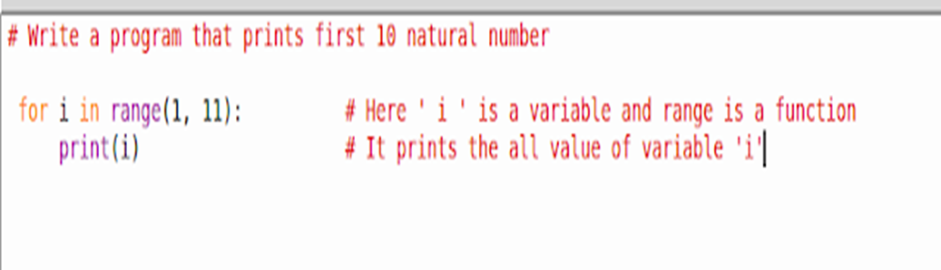
What is a ‘for’ Loop?
Basically ‘ for ‘ is a keyword of the python programming language used for repeat a task until a specific condition becomes True.
Syntax of ‘ for ‘ loop:
for < variable > in sequence:
statement block
An example of ‘ for ‘ loop

Slide 11
What is a ‘for’ Loop?
In the previous example, we take a variable name ‘ i ‘ which stores the value and with the help of print function it shows us the first 10 natural numbers.
Now, we use a function name range ()
Range() Function
The range() is a pre-defined function in python programming language used to iterate over a sequence of numbers. The syntax of range() is:
range( beginning, end, [step] )
NOTE: One important thing about range function is, it prints one less value of its last value. means if you write a program like — range( 1, 10) then, it only prints the number from 1 to 9.

Slide 12
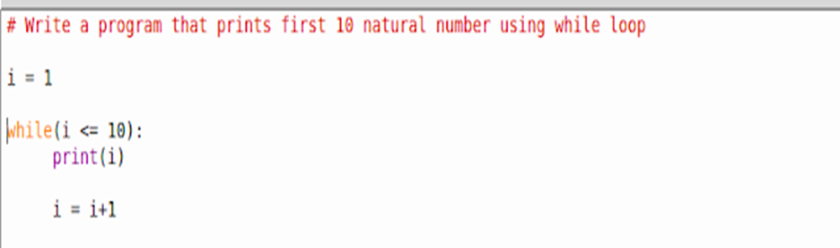
What is a ‘while’ Loop?
The while loop also works the same as for loop. The difference is only their syntax.
Syntax of while Loop
while ( condition ):
statement block
statement y
An Example of while loop

Slide 13
What is a ‘while’ Loop?
In the previous example, we print the first 10 natural numbers using a while loop.
At very first we initialize a variable named ‘ i ‘ and store a value 1 in it. After that, we create a while loop and put a condition over there that the loop works continuously until the value of ‘ i ‘ is not greater than 10 and print the all value of ‘ i ‘ until condition is not True.

Slide 14
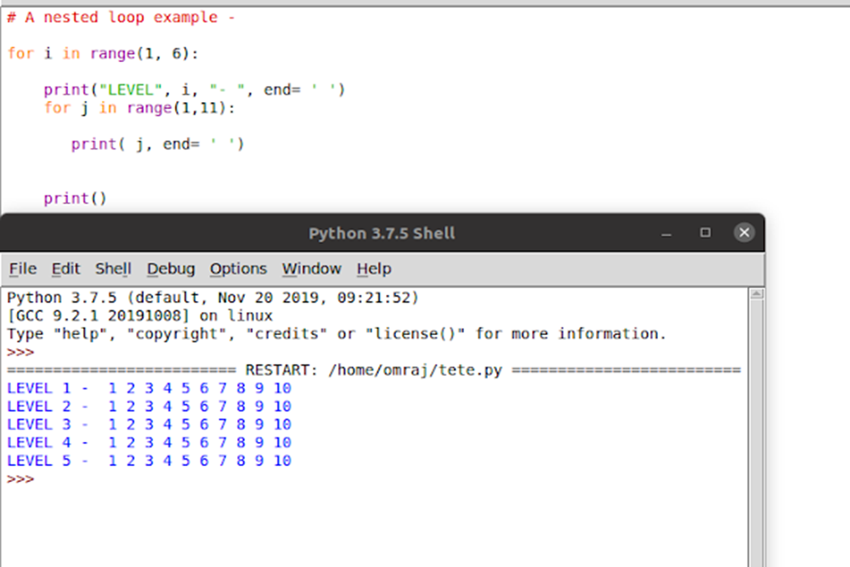
Nested Loop
Nested loop is nothing but a loop under a loop means you can also execute a loop under another loop.
See this example:

Slide 15
Summary
What is a Decision Control Statement?
The types of Decision Control Flow.
if statement.
if-else statement.
if-elif statement.
What is a Loop?
Why do we need to use a loop?
The types of loops.

